Slide 1


Evolutionary modelling with SecSSE
Presentation by
Poppy Mynard
Project supervisors
Leonel Herrera-Alsina
Justin Travis

Slide 2
Introduction

Slide 3
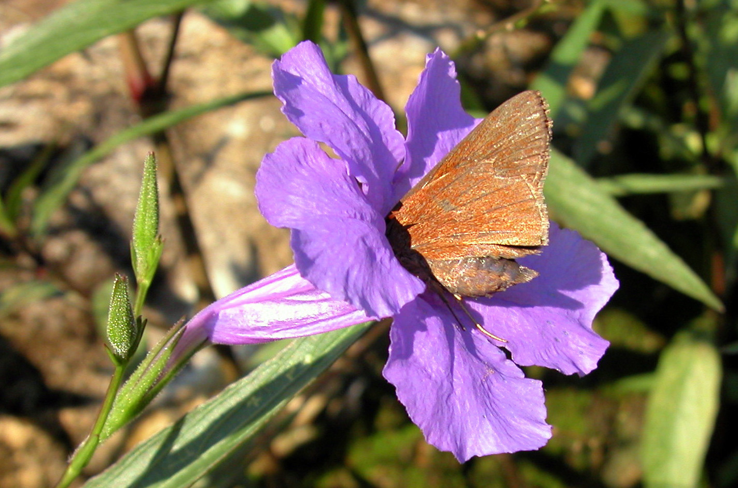

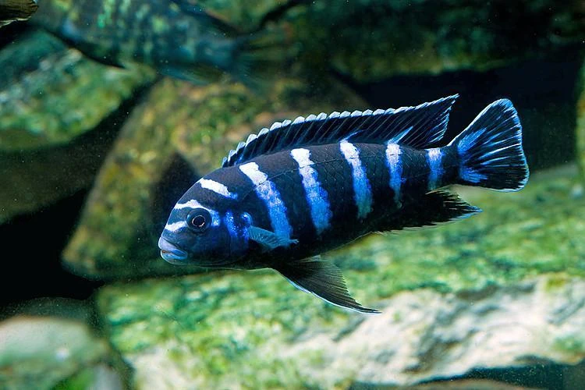
Species traits and evolution
Species traits can shape phylogenies by influencing diversification rates: rates of speciation and extinction
A key trait could be the main driver of diversification within a phylogeny
Pollinator specialisation
Seed size
Pharyngeal jaw
Notes:
Species traits can have active roles in shaping phylogenies by influencing net diversification rates, the rates of speciation and extinction.
A trait could promote speciation by increasing fitness, reproductive output, or migration.
Some trait-states may hinder speciation or increase extinction rates.
In the Ruellia plant genus, pollinator specialisation is suggested to lead to evolutionary dead-ends.
Seed size in angiosperms is correlated with their diversification.
The decoupled pharyngeal jaw is considered a key contributor to the radiation of African cichlid fishes.
Although a particular trait can have a strong influence on diversification and the evolutionary history of a lineage, often a combination of traits along with other factors (e.g. time, environment, stochasticity) collectively influence the shape of phylogenies and their diversification rates (Ricklefs 2007).
Due to these collective influences, the dependence of diversification upon traits, or the role that traits may have in shaping phylogenies, are difficult questions to answer.

Slide 4
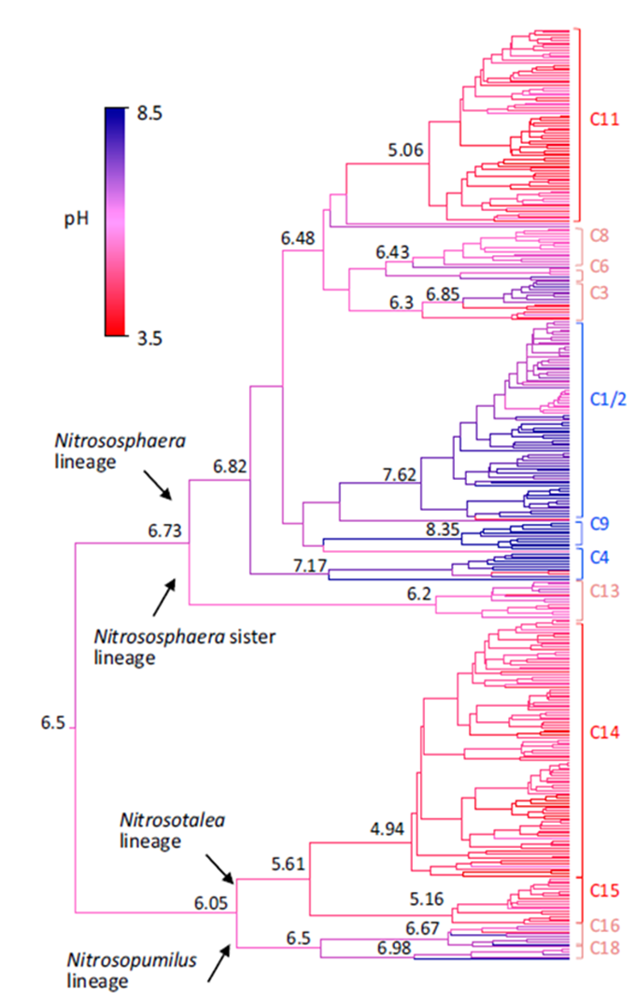
SSE Modelling
State-dependent Speciation and Extinction
Determine the impact of trait evolution on patterns of lineage diversification
Correlates the presence/absence of trait-states with diversification rates
Thaumarchaeota example
Gubry-Rangin et al. 2015
Notes:
SSE stands for state-dependent speciation and extinction
It is a type of modelling framework that was created to determine the impact that trait evolution has on patterns of lineage diversification through time.
It does this by correlating the presence/absence of trait states with diversification rates.
For example with the thaumarchaeota phylogeny, the SSE framework uses the phylogenetic tree and the species trait-state information to estimate the speciation and extinction rates and determine whether their diversification is dependent on pH adaptation.

Slide 5
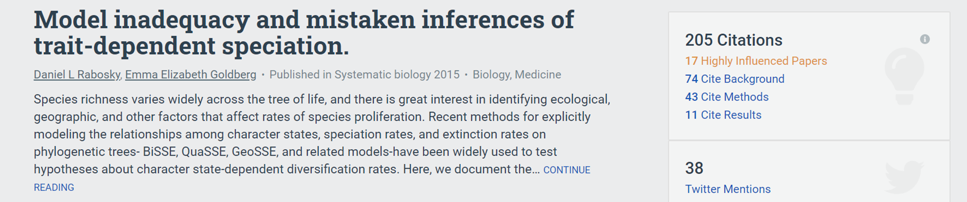
SSE Modelling
Early SSE models failed to consider the role of other traits in diversification
False inferences of trait-dependent diversification
Newer SSE models incorporate hidden traits to account for the possibility that diversification rates vary independently from the trait of interest
Notes:
False relationships between diversification and trait shifts were found using early SSE models, such as BiSSE and QuaSSE because these failed to consider the role of other traits in diversification
This led to high type 1 error rates and false inferences of trait dependent diversification
This is because in the complexities of diversification processes, a model with trait-based diversification is likely to appear more plausible when compared only to a simpler model, such as one with equal rates of diversification, even if the observed-trait was in fact neutral.

Slide 6
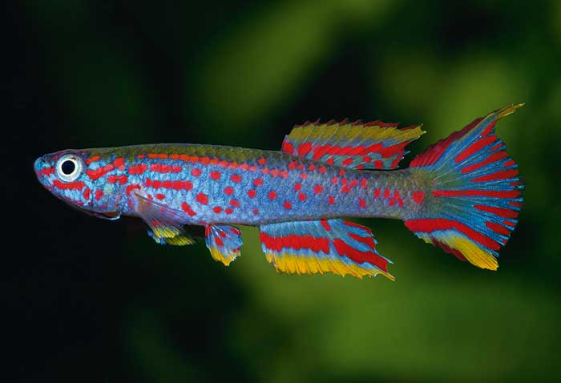
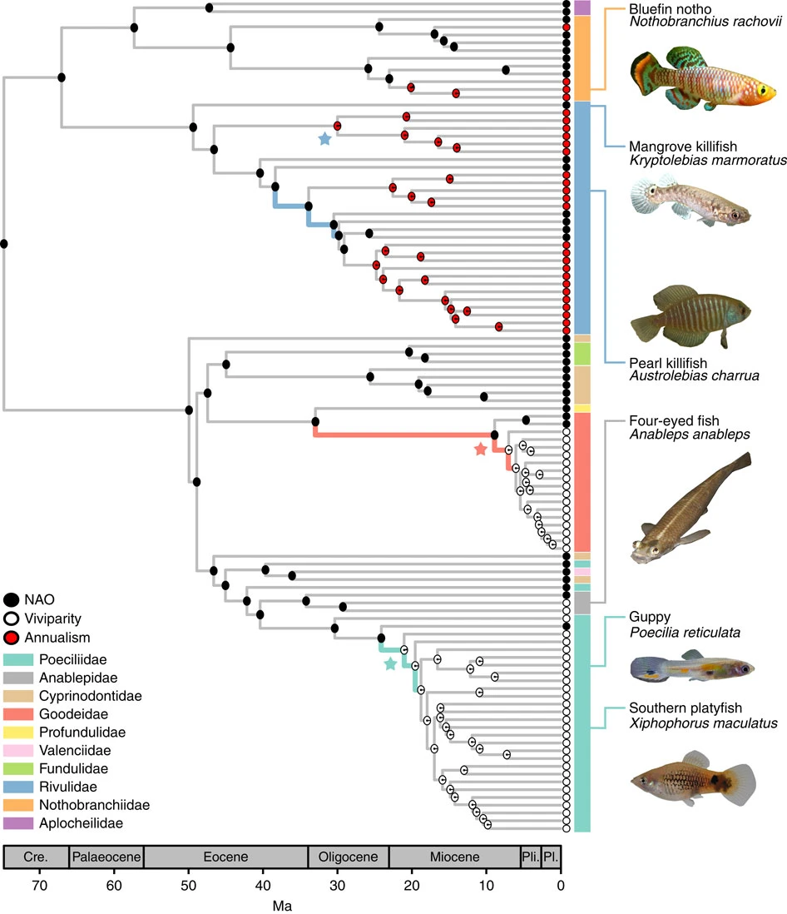
SecSSE
Several Examined and Concealed
State-dependent Speciation and Extinction
Accounts for hidden traits
Categorical trait-states
Combined effects of multiple traits
Partial trait-state information
Notes:
SecSSE is leonels SSE modelling framework
It infers state dependent diversification across observed traits while accounting for the role of possible hidden traits
It allows you to look at multiple categorical trait states and combined effects of multiple traits
It also lets you include partial trait-state information for example if some species trait-states are not known.
SecSSE was used to reanalyse results of studies published before the issues with early SSE models were realised: five out of seven studies were found to have significant effects from a concealed trait
They did find support for a study on fish (order Cyprinodontiformes) by Helmstetter et al. (2016), confirming that viviparity did increase diversification rates

Slide 7
Dependence of speciation on traits
λ1A 1 = observed trait value A = hidden trait value
Change in observed trait-state
Speciation rate
Constant Rates
(CR)
λ1A = λ2A = λ1B = λ2B
Examined Trait dependent
(ETD)
λ1A = λ1B ≠ λ2A = λ2B
Concealed Trait dependent
(CTD)
λ1A = λ2A ≠ λ1B = λ2B
+
+
+
-
-
-
Time
Time
Time
Notes:
The constant rates model on the left has a diversification rate that does not vary over time
The examined trait dependent model has changes in diversification rate that correspond with the changes in the examined trait
The concealed trait dependent model has changes in diversification rate that do not match with changes in the examined trait
These different model types are compared to determine which is the most likely

Slide 8
Dependence of speciation on traits
λ1A 1 = observed trait value A = hidden trait value
Change in observed trait-state
Speciation rate
+
Constant Rates
(CR)
λ1A = λ2A = λ1B = λ2B
λ
-
Time

Slide 9
Dependence of speciation on traits
λ1A 1 = observed trait value A = hidden trait value
Change in observed trait-state
Speciation rate
+
Examined Trait dependent
(ETD)
λ1A = λ1B ≠ λ2A = λ2B
λ
-
Time

Slide 10
Dependence of speciation on traits
λ1A 1 = observed trait value A = hidden trait value
Change in observed trait-state
Speciation rate
+
Concealed Trait dependent
(CTD)
λ1A = λ2A ≠ λ1B = λ2B
λ
-
Time

Slide 11
Dependence of speciation on traits
λ1A 1 = observed trait value A = hidden trait value
Change in observed trait-state
Speciation rate
Constant Rates
(CR)
λ1A = λ2A = λ1B = λ2B
Examined Trait dependent
(ETD)
λ1A = λ1B ≠ λ2A = λ2B
Concealed Trait dependent
(CTD)
λ1A = λ2A ≠ λ1B = λ2B
+
+
+
-
-
-
Time
Time
Time
Notes:
These different model types are compared to determine which is the most likely

Slide 12
Model comparison and parameter estimation
Model comparison: selecting the best model from ETD, CTD, CR
- Models are compared using likelihood (AIC) values
Parameter estimation
λ1, λ2, λ3 μ q
Speciation Extinction Transition
rates rate rates

Slide 13
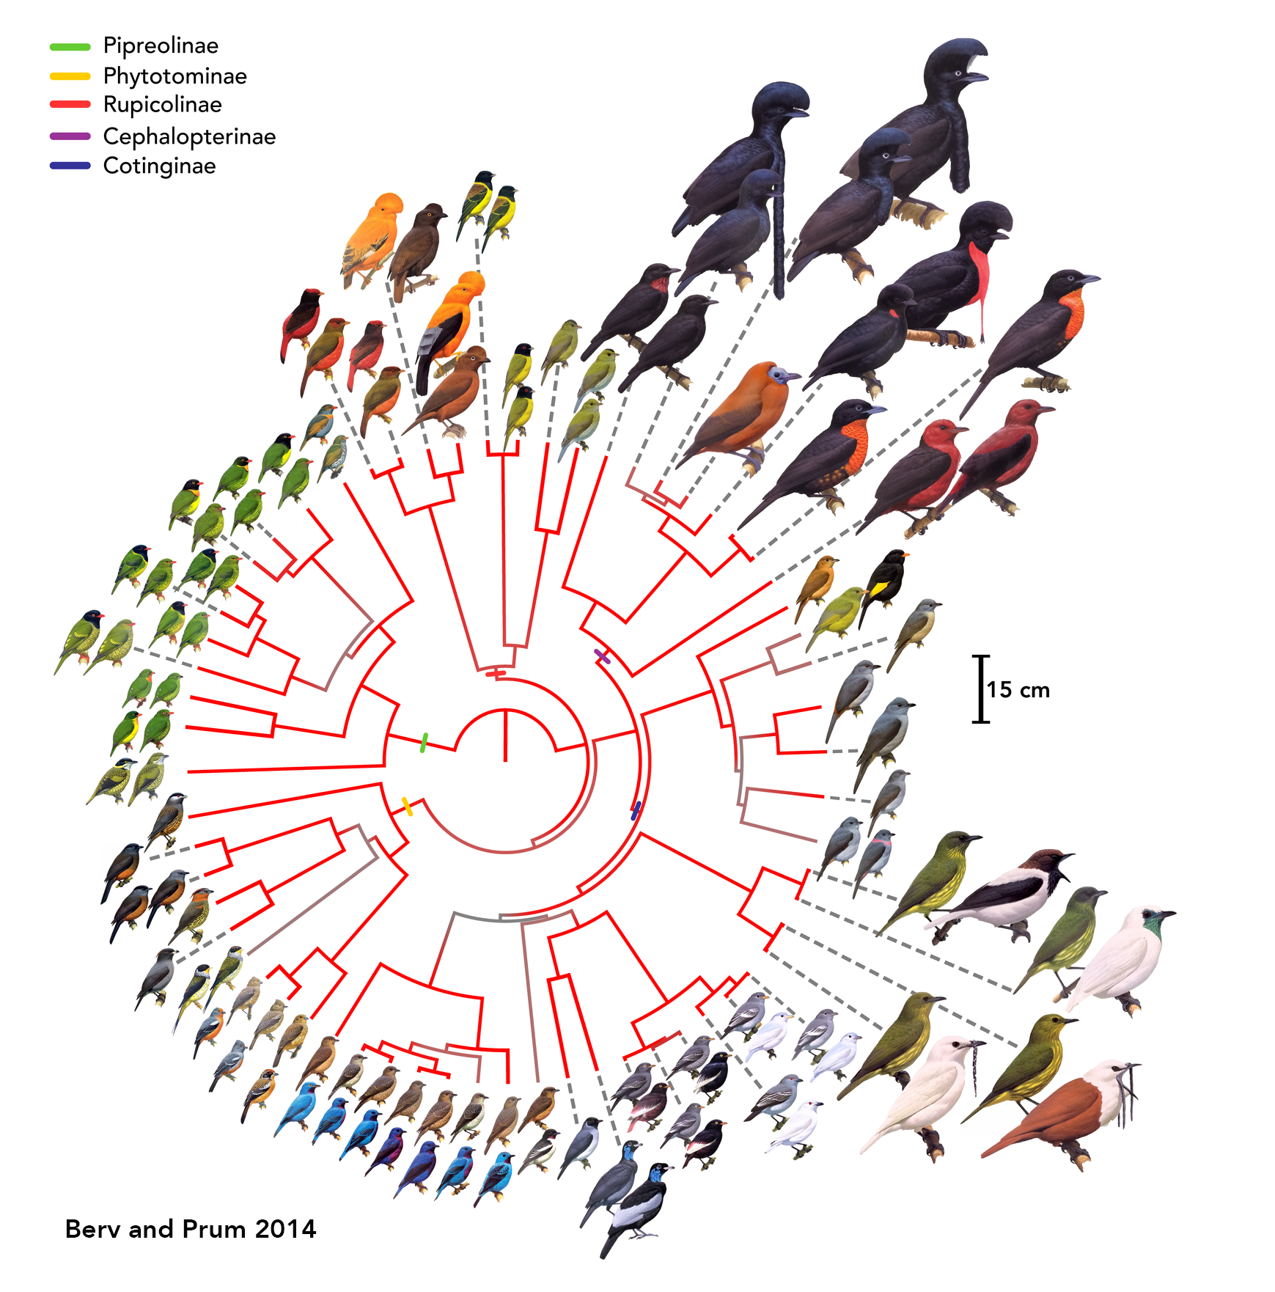
The accuracy of model comparison and parameter estimation is dependent upon…
?
Accuracy of the phylogenetic tree
Completeness of trait information
Similarity of speciation rates
Sampling fraction of the phylogeny
?
?
?
Notes:
The accuracy of parameter estimation and model selection is dependent on several factors
Variation in the phylogenetic tree adds uncertainty to models - there are any number of phylogenies that are (almost) equally probable, but they are not identical – and this variation may influence SSE analyses
Incomplete trait information adds another element of uncertainty to models
And the more similar the speciation rates, the more difficult it is to find evidence of trait dependency
The sampling fraction i.e. what percentage of the phylogeny has been sampled can also affect model accuracy

Slide 14

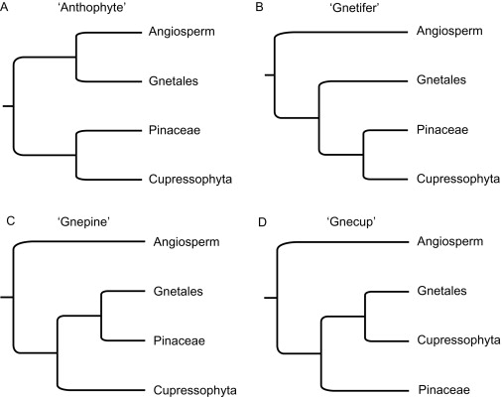
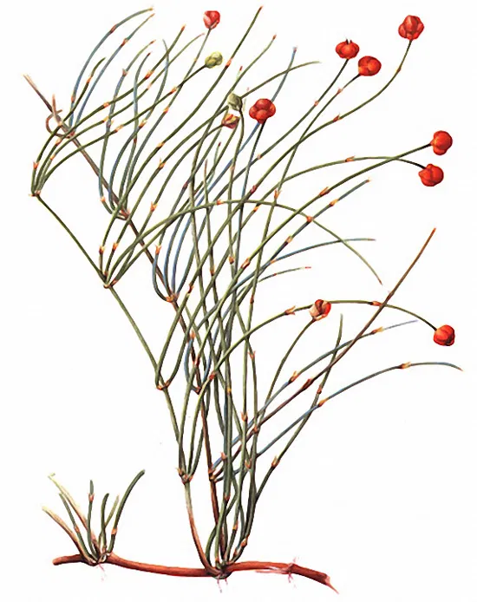
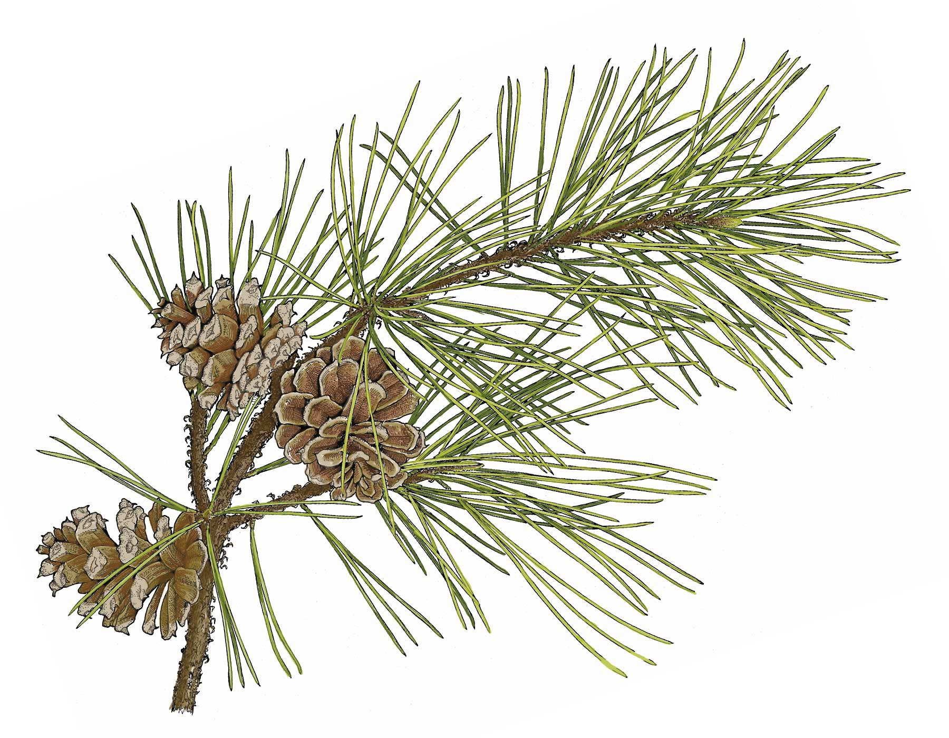
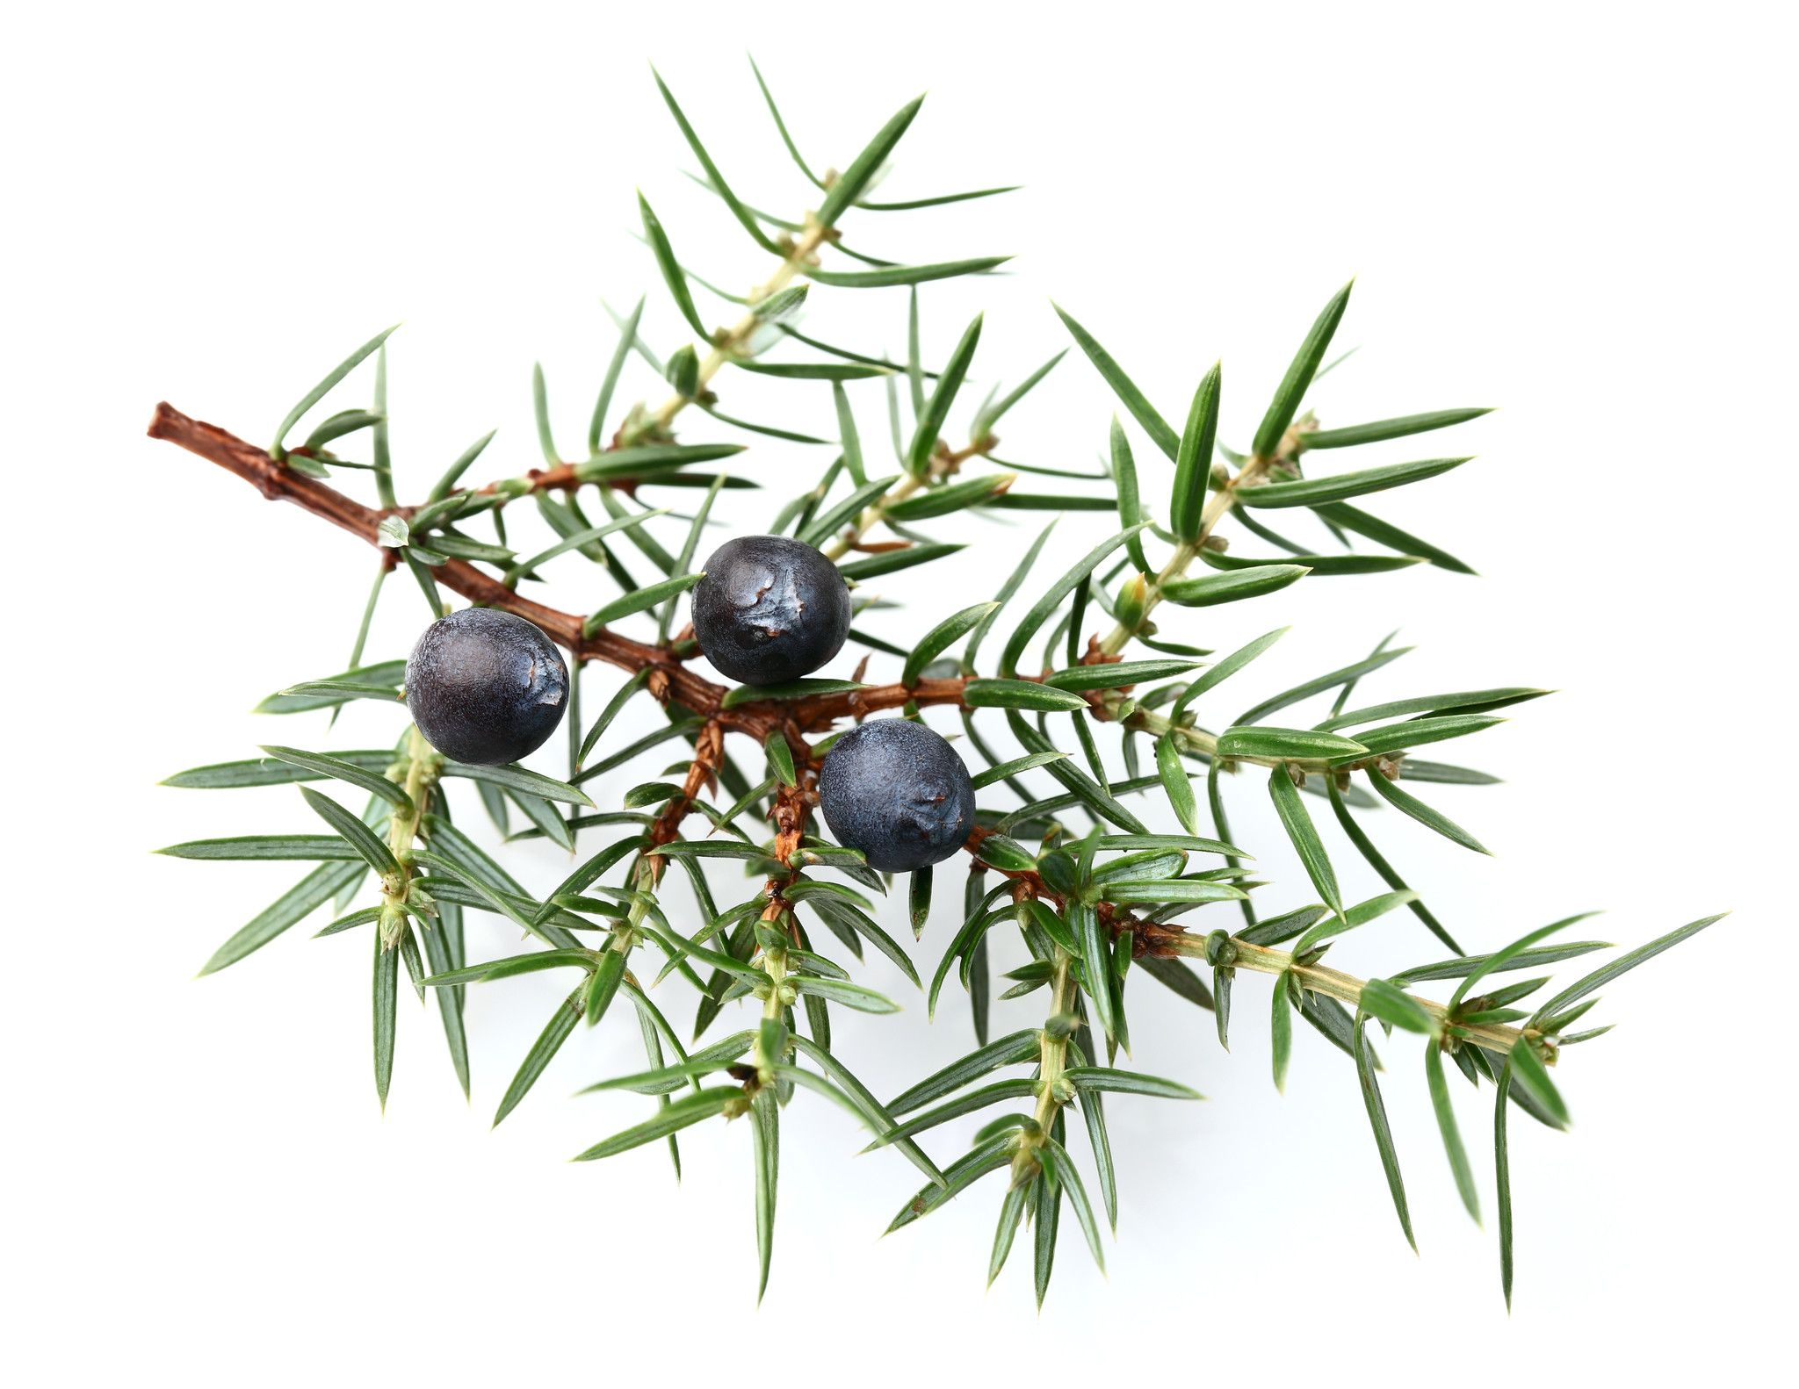
Accuracy of the phylogenetic tree
?
?
?
?
Equally probable but non-identical phylogenies
Different speciation and extinction rates
Different phylogenetic tree shapes
Notes:
Variation in the phylogenetic tree adds uncertainty to models - there are any number of phylogenies that are (almost) equally probable, but they are not identical – and this variation may influence SSE analyses

Slide 15
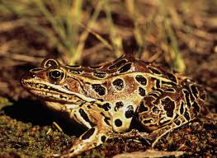
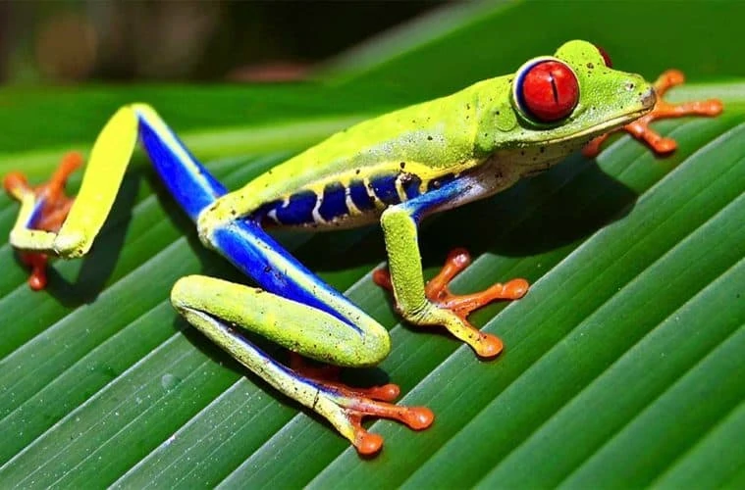
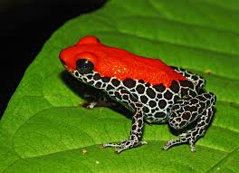
Completeness of trait information
?
?
?
?
Unknown trait-states for some species more uncertainty
Camouflage
Unknown
Warning

Slide 16
Similarity of speciation rates
?
?
?
?
More similar harder to find evidence of trait dependency
speciation rates (λ): 0.1, 0.15, 0.18
Harder
speciation rates (λ): 0.1, 0.4, 0.6
Easier

Slide 17
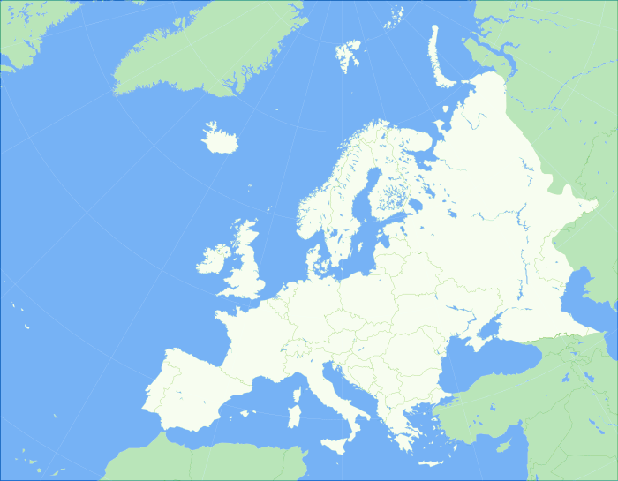


?
?
?
?
Sampling Fraction
Phylogenies may be incompletely sampled due to….
Lack of molecular
material
Geographical
limitations
Unknown number
of species
Notes:
Phylogenies are often incomplete, usually due to lack of molecular material. Diversification analyses are normally intended for entire (complete) clades, but phylogenies may be incompletely sampled, or only a section may be chosen to be analysed. For example, the taxonomic scope of a study could be geographically limited, or the number of species in the entire clade may not be know (e.g. in microbes).

Slide 18
Research Questions
How does model selection and parameter estimation vary with sampling fraction?
Does sampling method (random or bias) affect the analyses?
Explored under two assumptions
Sampling fraction is known
Sampling fraction is unknown and mis-specified

Slide 19
Methodology

Slide 20
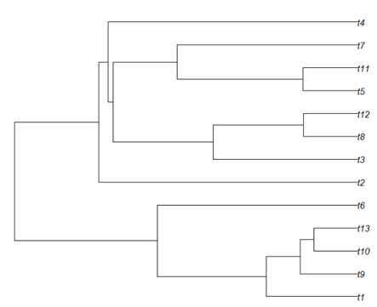

Making Trees
Generated 100 trees of each type (ETD, CTD and CR) in each size:
large medium small
(1000 – 5000) (450 – 650) (100 – 250)
Parameters:
speciation rates (λ) extinction rate (μ) transition rate (q)
0.1, 0.3, 0.5 0.001 0.4
Notes:
I used R and some packages and code from Leonel to generate 100 phylogenies that were examined trait dependent and 100 that were concealed trait dependent.
All of the trees has between 1000 and 5000 tips because they needed to still be large enough for SecSSE analysis after severe trimming
The observed trait had three trait states as did the concealed trait
There were 3 speciation rates, 1 for each trait state, one extinction rate, and one transition rate, this is the rate at which they change trait states

Slide 21
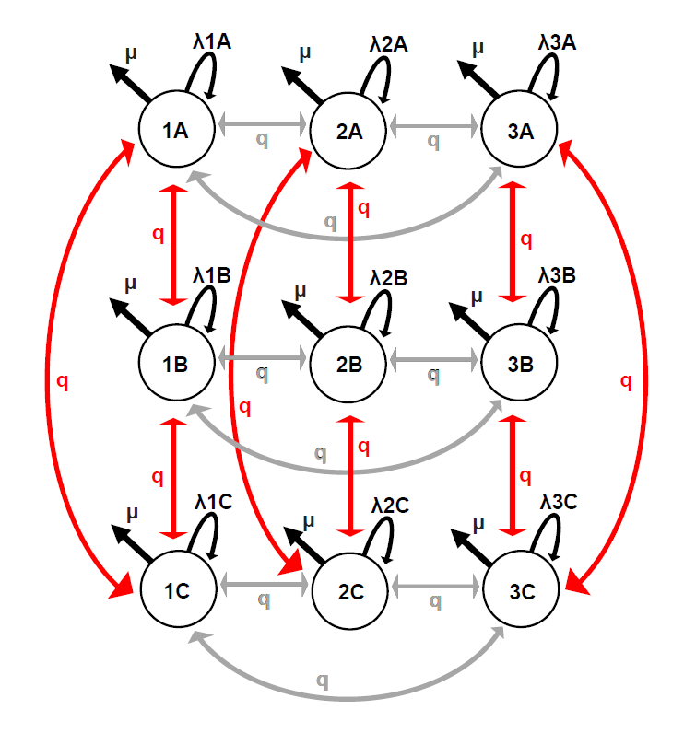
The parameters
λ = speciation rates
0.1
0.3
0.5
μ = extinction rate = 0.001
q = transition rate = 0.4

Slide 22
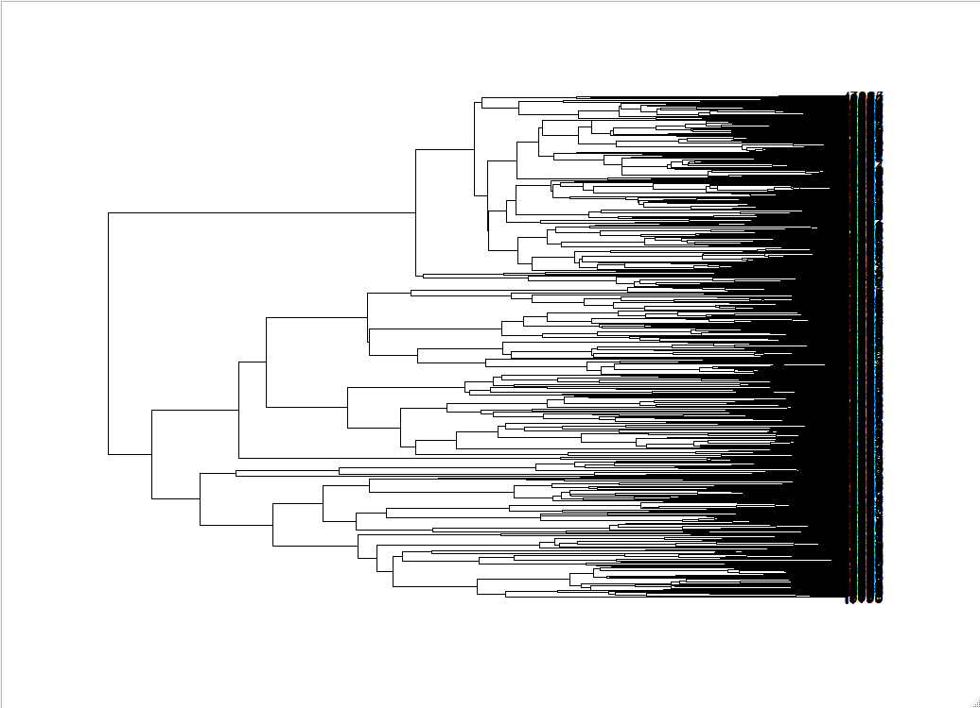
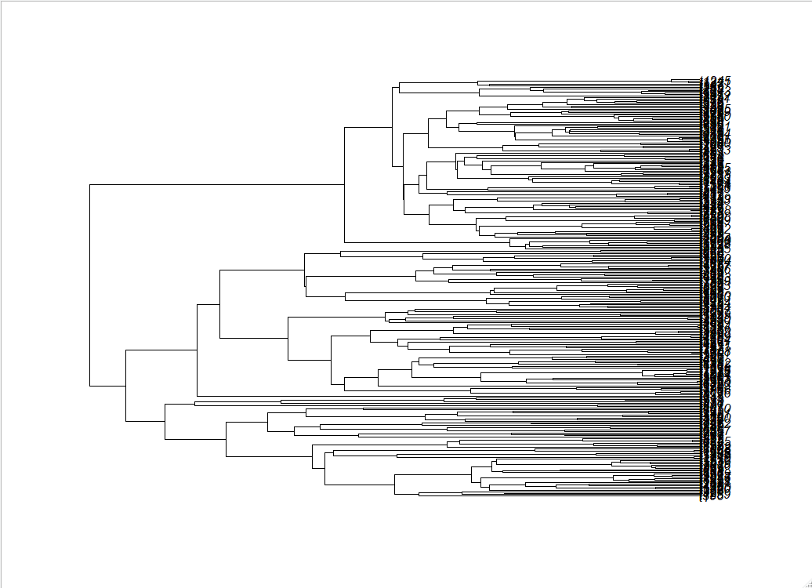
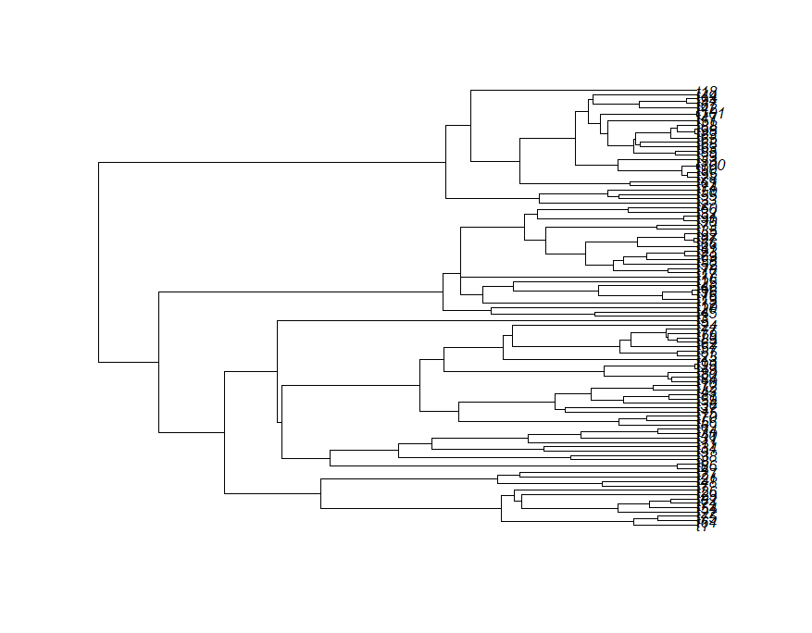
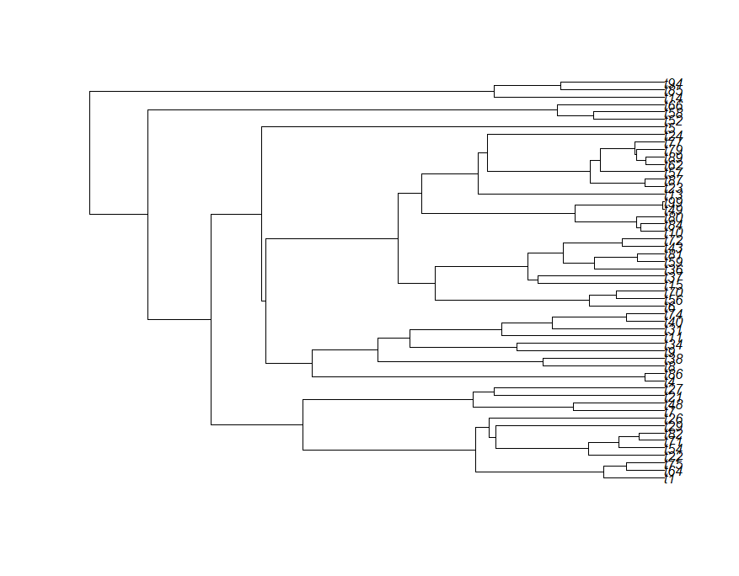
Bias
Trimming Trees
Random
5 sampling fraction sets:
100% 80% 60% 40% 20%
X
X
X
X
Notes:
5 sampling fraction sets: 100%, 80%, 60%, 40%, 20%

Slide 23
Study Groups
 | Randomly trimmed | Bias trimmed
True SF (%) 100, 80, 60 , 40, 20 | large, medium, small | medium
Mis-specified SF | medium | medium

Slide 24
Mis-specifed sampling fraction sets
True SF | Mis-specified SF
100 |  | 80
80 | 100 |  | 60
60 | 100 | 80 |  | 40
40 | 100 | 80

Slide 25
Results

Slide 26
Randomly Trimmed trees, True SF
SecSSE performed better with large trees and trees with high SF
Model Selection (ETD generated trees)
Large: 100% correct at SF 40
Medium: 93% correct at SF 40
Small: 89% correct at SF 80; 45% correct at SF 40
Small trees are too small

Slide 27
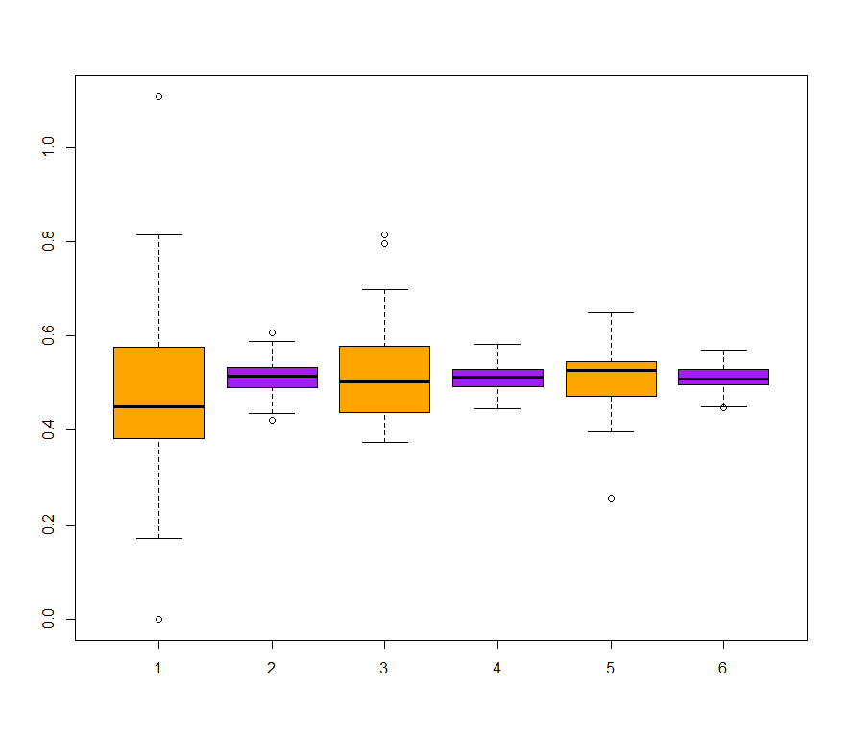
Parameter estimates: big vs small trees
Actual
value:
0.5
Speciation rate 3 (λ)
Big trees
Small trees
40
60
80
Sampling Fraction (%)

Slide 28
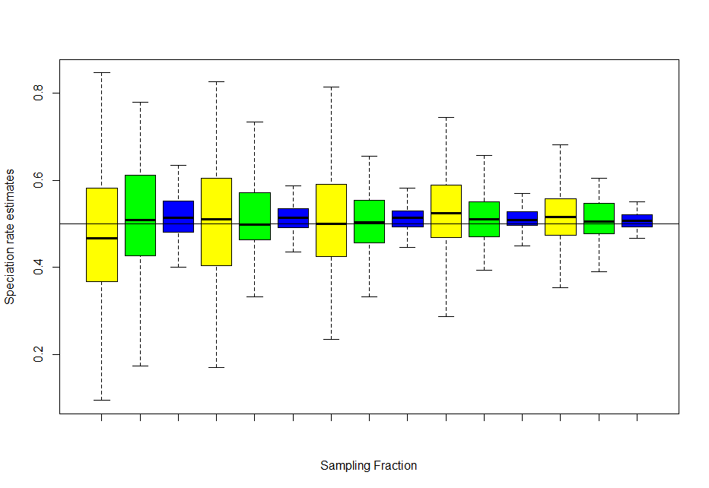
Parameter Estimation
Tree Size
Big
Speciation rate 3 estimates
Medium
Small
20%
40%
60%
80%
100%
Sampling Fraction

Slide 29
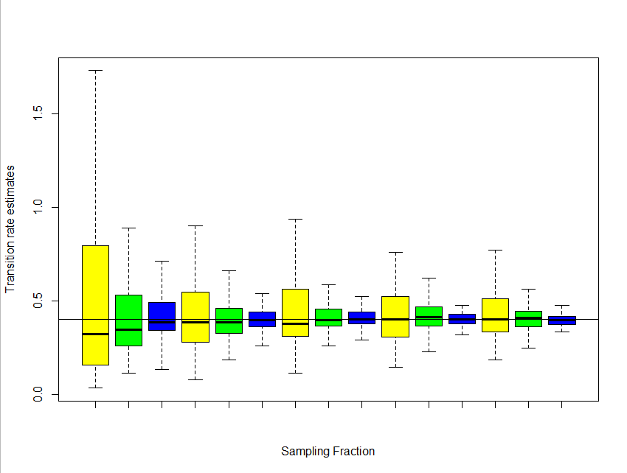
Parameter Estimation
Tree Size
Big
Medium
Transition rate estimates
Small
20%
40%
60%
80%
100%
Sampling Fraction

Slide 30
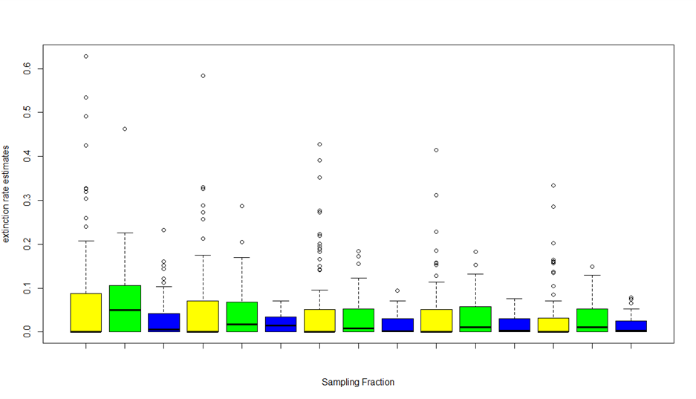
Parameter Estimation
Tree Size
Big
Medium
Extinction rate estimates
Small
20%
40%
60%
80%
100%
Sampling Fraction

Slide 31
+
Model Selection
False positives: ETD selected when ETD was not the generating model
-
Time
 | SF 100 | SF 80 | SF 60 | SF 40 | SF 20
Large | 11.5 | 11.5 | 10 | 25 | 28.5
Medium | 22 | 22 | 26.5 | 32.5 | 36
Small | 31 | 31.5 | 43 | 44 | 45

Slide 32
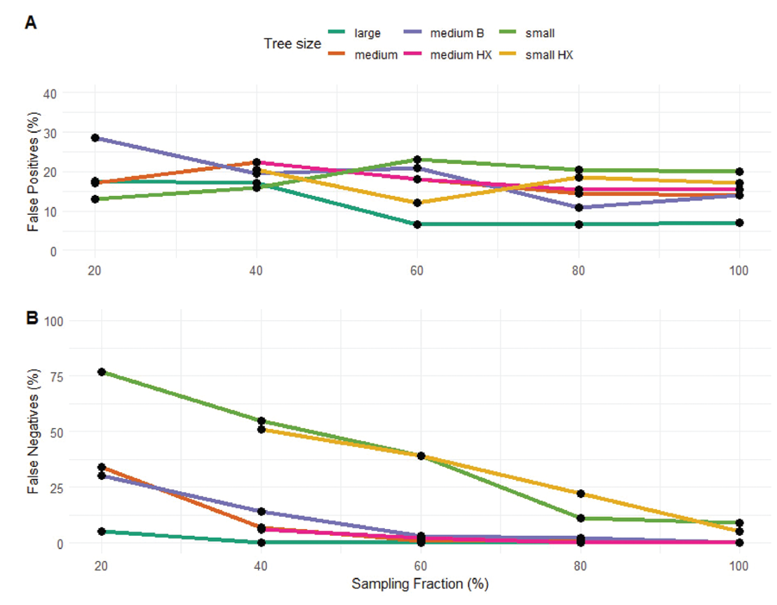
Notes:
False positves and false negatives from correctly specified sampling fraction sets

Slide 33
Mis-specifying Sampling Fraction
Mis-specifying SF generally increased false positives
For model selection, setting the SF too high was slightly worse than setting the SF too low
For parameter estimation, setting the SF too high and too low were bad in different ways

Slide 34
True SF | Mis-specified as… | False Positives (%) | FP compared to true SF set
100 | 80 | 20.6 | Higher
80 | 100 | 26.6 | Higher
 | 60 | 21.4 | Similar
60 | 100 | 31 | Higher
 | 80 | 27.4 | Similar
 | 40 | 24 | Lower
40 | 100 | 40.4 | Higher
 | 80 | 36.5 | Higher

Slide 35
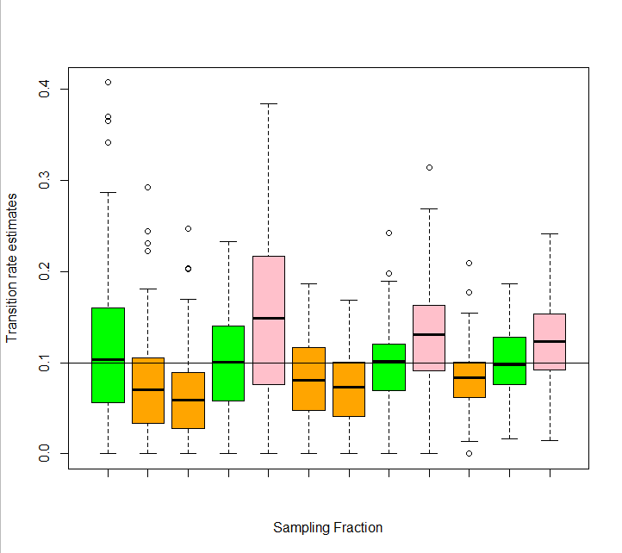
Parameter Estimation
Randomly trimmed trees
Sampling Fraction
Too high
Speciation rate 1 estimates
True
Too low
40%
60%
80%
100%
Sampling Fraction

Slide 36
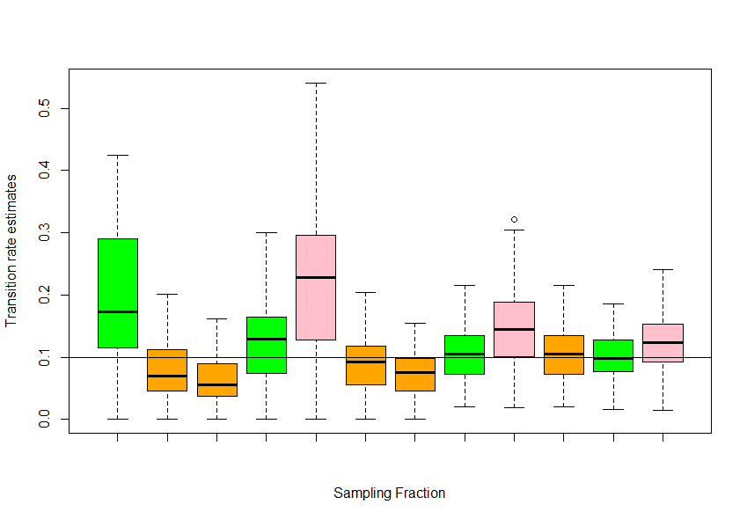
Parameter Estimation
Bias trimmed trees
Sampling Fraction
Too high
Speciation rate 1 estimates
True
Too low
40%
60%
80%
100%
Sampling Fraction

Slide 37
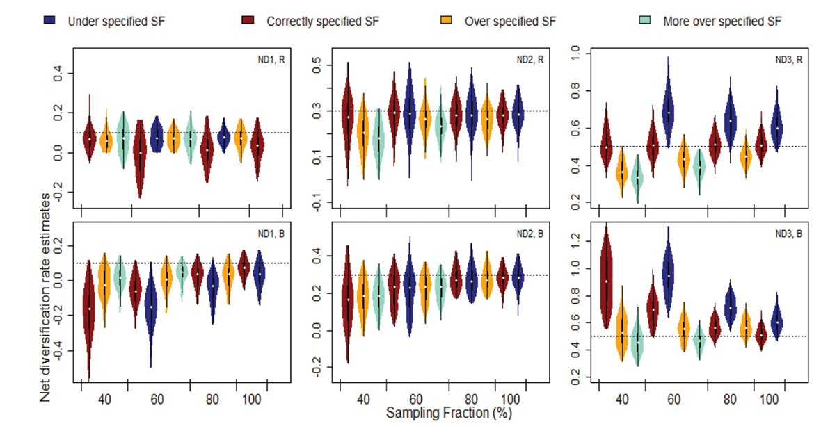
Notes:
Net diversification rate estimates of the medium size ETD generated phylogenetic trees. The horizontal line indicates the true parameter value.
Randomly (top row) or biased trimmed (bottom row).
The first column is trait state 1, the second is trait state 2 and the third is trait state 3.
Colours indicate if the sampling fraction was correctly specified or mis-specified.

Slide 38
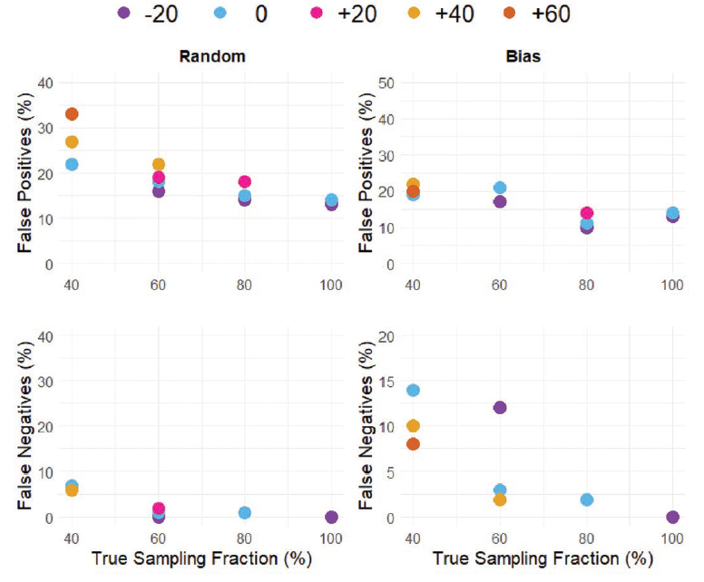
Difference from true SF

Slide 39
Discussion

Slide 40
Effects of Sampling Regime
When sampling of the tree is imbalanced across sub-clades and tree completeness is ≤ 60%, rates of false positives increase and parameter estimates are less accurate, compared to when sampling is random.
When applying SSE methods to empirical datasets, there are increased risks of false inferences of trait dependent diversification when some sub-clades are heavily under-sampled.

Slide 41
Conclusions
Model selection and parameter estimation are negatively affected by low sampling fractions
Larger and more complete trees are more suitable for SSE analyses
Mis-specification of sampling fraction reduces model power and leads to inaccurate parameter estimates
Parameter values are over-estimated when SF is set lower than it’s true value and under-estimated when SF is set too high.

Slide 42
Recommendations
It may be better to use a larger but somewhat incomplete phylogeny, rather than a smaller but more complete subclade.
Taxonomic biases in sampling can be problematic when phylogenetic trees are < 80% complete. We recommend assessing the degree of bias in sampling in your phylogenetic trees.
If possible, additional sampling of missing tips is advised, to reduce sampling bias.

Slide 43
Recommendations
For SSE methods, we do not recommend excluding tips from phylogenetic trees, as this lowers the SF, increases uncertainty in the model, and may increase sampling bias.
We advise that SSE modelling is most suitable for incomplete phylogenies when the number of extant species in the clade is known with some accuracy.
It is worth conducting a thorough examination of the phylogeny to estimate the SF as precisely as possible.

Slide 44
The Publication Process

Slide 45
The Publication Process…
↓
More work – additional modelling, recommendations in the discussion
↓
The Journals Decision: Accept pending minor revisions.
↓
Small changes – adjusting figures and clarifying text
↓
The Journals Decision: Accepted!
Submitted to Systematic Biology
↓
The Journals Decision: Reject; resubmission encouraged
↓
More work needed – Bayesian SSE modelling
↓
The Journals Decision: Reject; resubmission encouraged
↓

Slide 46
How long was the process?
It is not always this long!!
Journal first received the paper 5 April 2021
Journal accepted the paper 15 January 2023
Was it worth it?
YES!!!

Slide 47
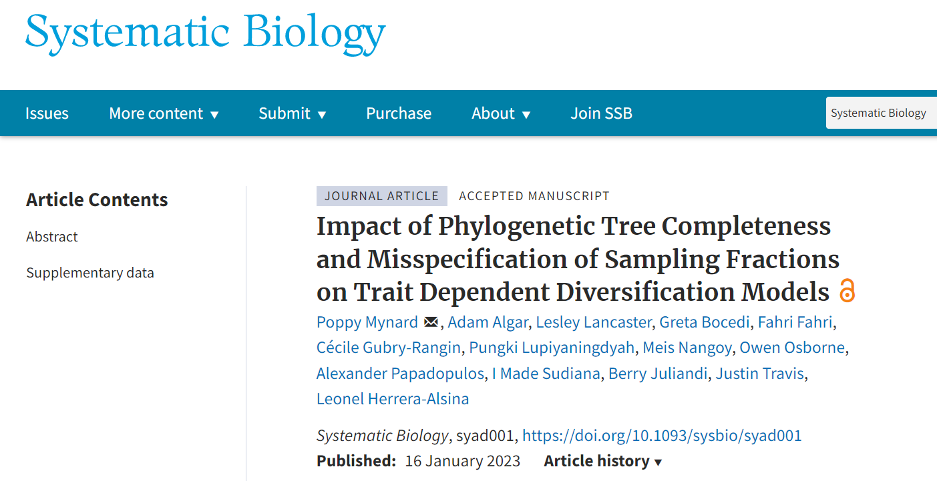
Now it’s published!!!

Slide 48
Thank you

